Slide 1
Presentation on Micro-Credit Defaulter prediction using Machine Learning
Presented by
R.Sujanitha

Slide 2
Introduction
What is Micro Credit?
Problem Statement
Data Preprocessing
Exploratory Dat a Analysis
Feature Engineering
Machine Learning Building
ROC-AUC curve of Different Model.
Limitations and future scope of work

Slide 3
What is Micro credit?
Micro credit is an extremely small loan given to those who lack a steady source of income, collateral. It is used as a way to obtain a loan, acting as a protection againest potential loss for the lender should the borrower default his payments, or any credit history.

Slide 4
Problem statement
Telecom Provider provide micro-credit on mobile balances to be paid back in 5 days.
Loan Varity:
Loan amount of 5-payback amount 6(indonesian Rupiah)
for the loan amount of 10(in Indonesian Rupiah), the payback amount should be 12(in Indonesian Rupiah).
Build a model which can be used to predict in terms of a probability for each loan transaction, whether the customer will be paying back the loaned amount within 5 days of insurance of loan.

Slide 5
Dataset Information
Dataset provided by Fliprobo Technologies Ltd.
Micro credit Defaulter dataset contain 209593 rows and 37 columns.
Out of all features only 3 features with object datatypes and rest are int64.
Data integrity check is perform for missing values, duplicate data,data error.
No missing values, white spaces, ‘NA’,’-’ are present in the dataset.

Slide 6
Data Pre-processing
Strategy to handle Data error in min max column.
Assumption: All negative values are typing error happen accidentally by type-infront of original value(except feature depicting median)
Corrective Approach: Negative values are converted into asolute value to correct negative typing error whenever applicable except feature depicting median.
Feature Engineering on ‘pdate’ column: Extracting new columns for day, month and year out of ‘pdate’
Data error and correction in maxamnt_loan30 column
The maximum value in maxamnt_loan30 is not reliable.
Assumption: The maximum value in maxamnt_loan30 is 12.
Corrective action: Replacing values greater than 12 into category of zero.
Dropping Unnecessary columns:

Slide 7
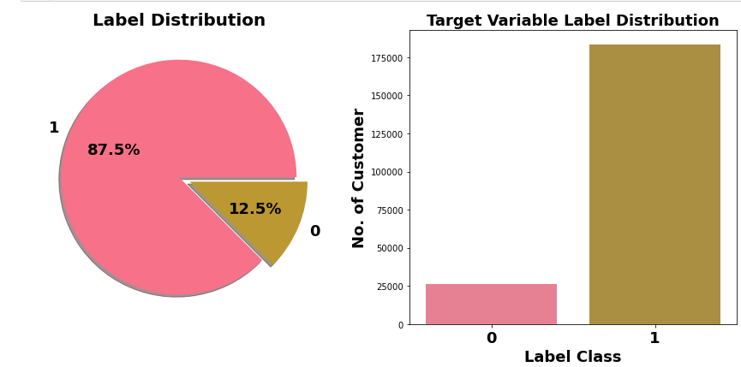
Exploratory Data analysis
Label class 1 represent Non-defaulter while Label class 0 represent Defaulter i.e. Loan not paid We can see Most of customers are Non-defaulter while very few are defaulter. From ML model building point of view target variable is imbalanced data case.

Slide 8
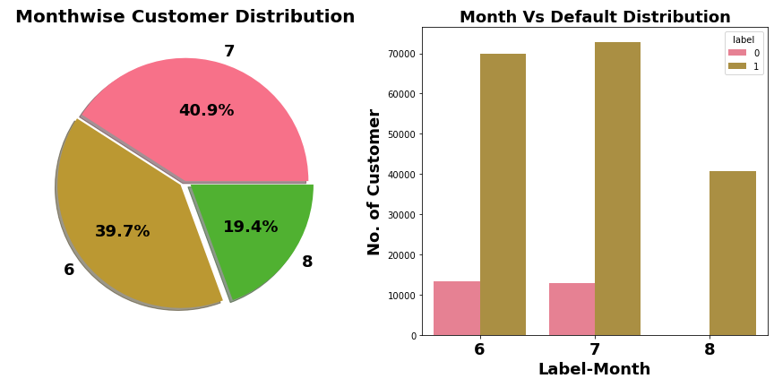
Exploratory Data Analysis Month VS Defaulter Distribution
Most of data belong to month 6 and 7, followed my month 8. We can see very few defaulter in month 8.

Slide 9
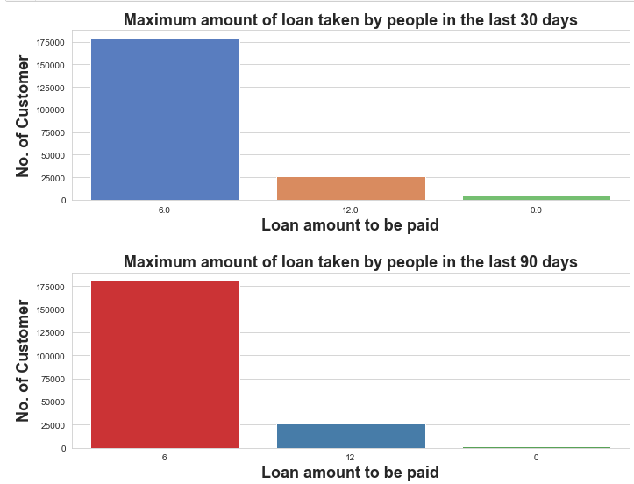
Exploratory Data analysis Maximum amount of loan taken by people
In 30 & 90 days, maximum number of people had taken 6Rs as the loan amount.
Customers have less tendency to take loan in amount of 12.
There are very few people who do not taken loan.

Slide 10
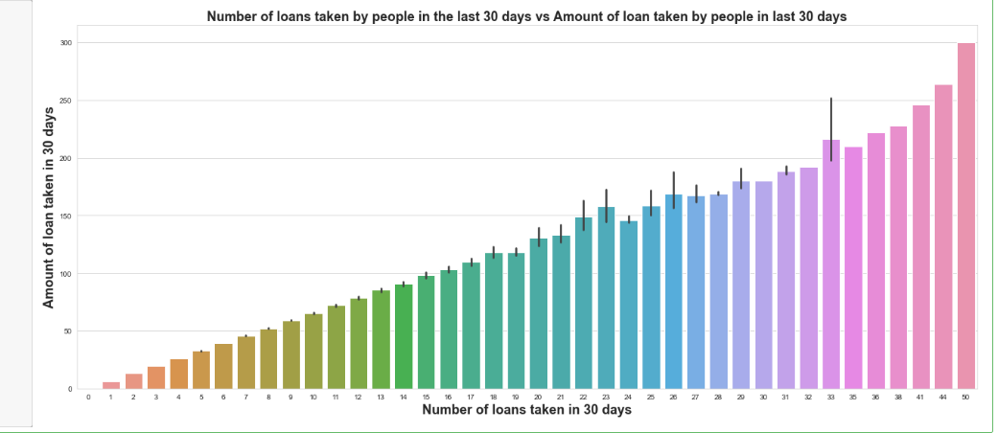
Exploratory Data analysis Number of loans taken by people in last 30 days vs Amount of loan taken by the people in last 90 days
Maximum number of loans taken by the people is 50 and the Average loan amount is equivalent to 300.
Minimum number of loans taken by the people is 0.

Slide 11
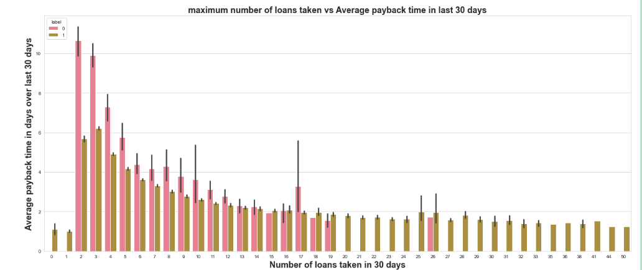
Exploratory data Analysis Maximum number of loans taken vs Amount payed within due dates by people or not on the basis of label
We can observe that the Average payback time over last 30 days is higher for people who had taken 2 times the loan and say that the users with less number of loan taking are more than the defaulters

Slide 12
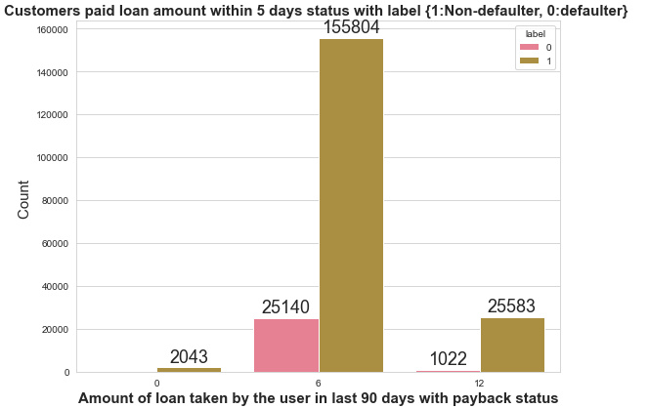
Exploratory Data Analysis Number of Customer taken loan in 30 days
Very few defaulter in customers who take loan in amount of 12.

Slide 13
Feature Engineering Outliers detection and removing
Outliers do not exist in lower bound but outliers exist in upper bound of features.
Z-score method results in huge data loss of 23.42%, which we can not afford.
Quantile-based Flooring-capping method employed for outliers removal.
Flooring is performed at 0th percentile for lower bound and capping perform at 99 th percentile for upper bound.
Data Loss: 5.44% which is acceptable.

Slide 14
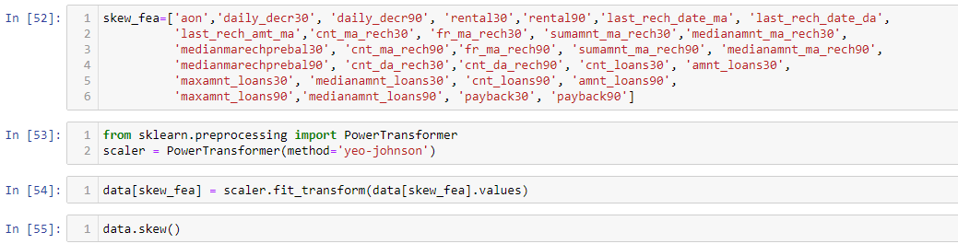
Exploratory Data Analysis Skewness detection & transformation
Considerable amount of skewness exist in different features.
Yeo-Johnson Power Transformation used to reduce skewness

Slide 15
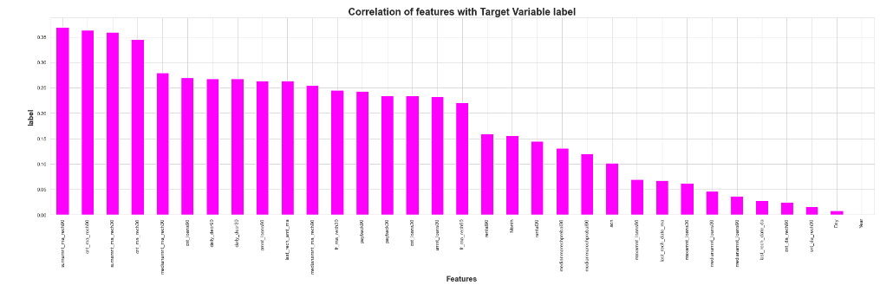
Correlation
Most of independent features are poorly or moderately correlated with target variable label

Slide 16
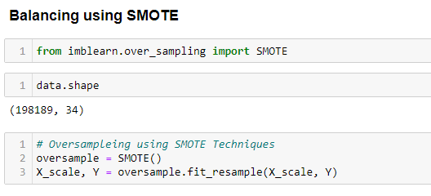
Handling Imbalanced data
Target Variable label is Imbalanced in nature.
SMOTE techniques used to oversample minority class.

Slide 17
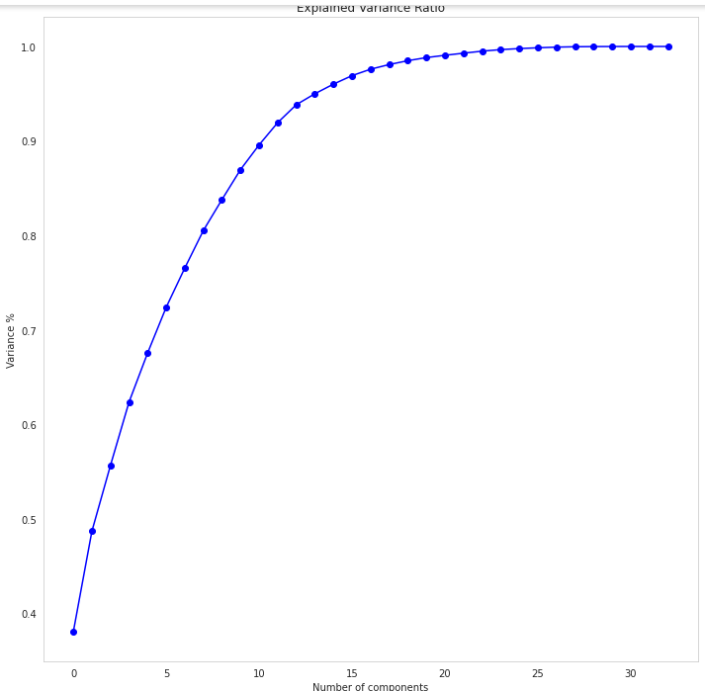
Multi collinearity and PCA
Multicollinearity exist between few features.
To resolve it PCA is applied.
Eleven principal components attribute for 90% of variation in the data.
PCA applied for Eleven components.

Slide 18
Machine Learning Model Building
Objective is to predict customer is defaulter or not. It can be solved by application of classification ML algorithm.
Different classification algorithm used to train model, in order to have maximum accuracy score.
Machine learning classification algorithms used in this project are:
1. Logistic Regression
2. Decission Tree Classifier
3. Random Forest Classifier
Extra Tree Classifier

Slide 19
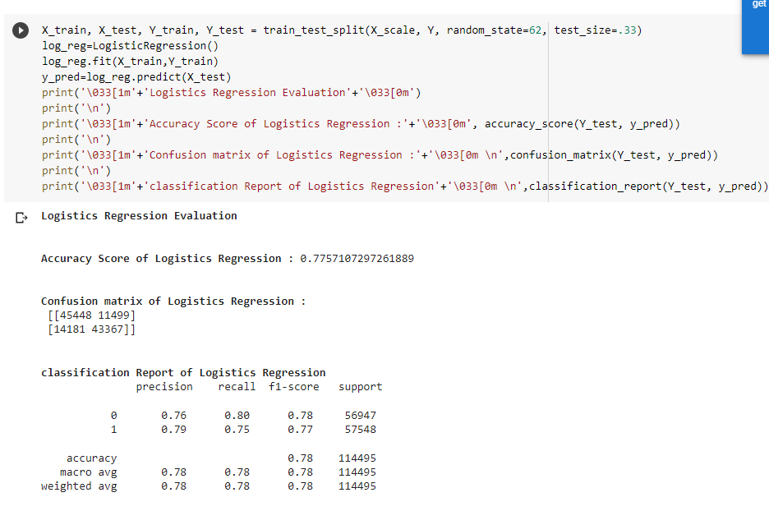
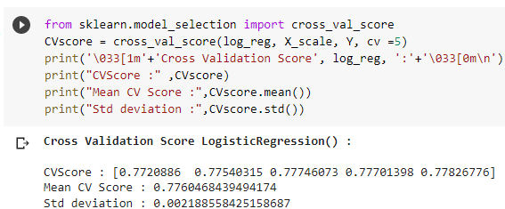
Logistic Regression

Slide 20
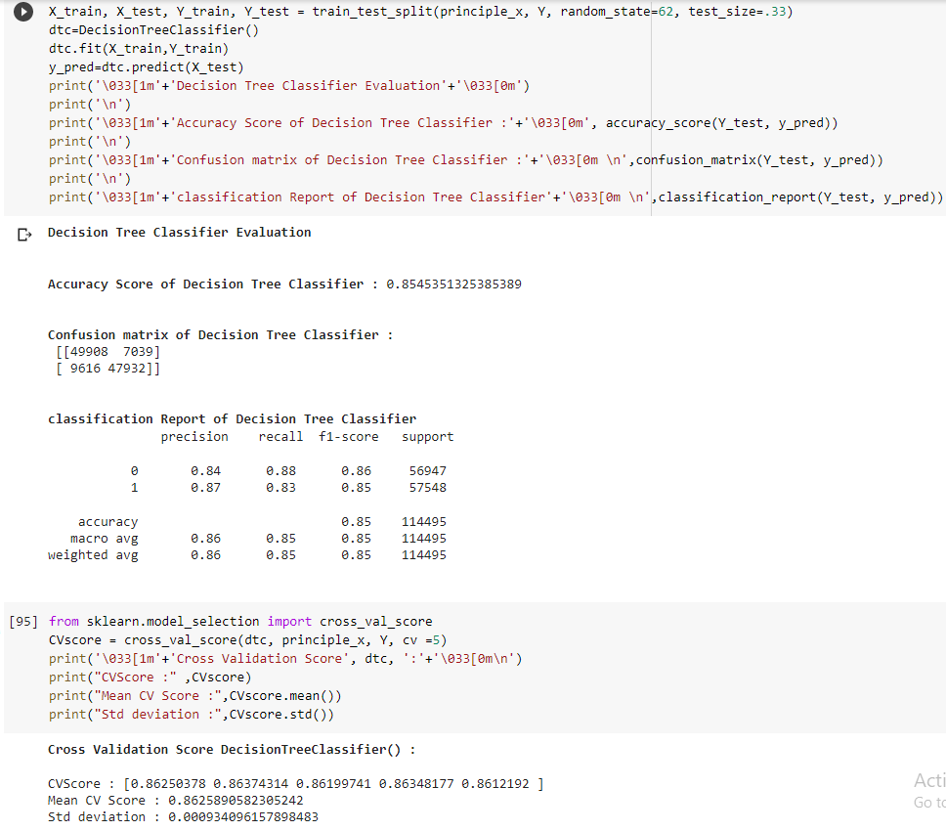
Decision Tree Classifier

Slide 21
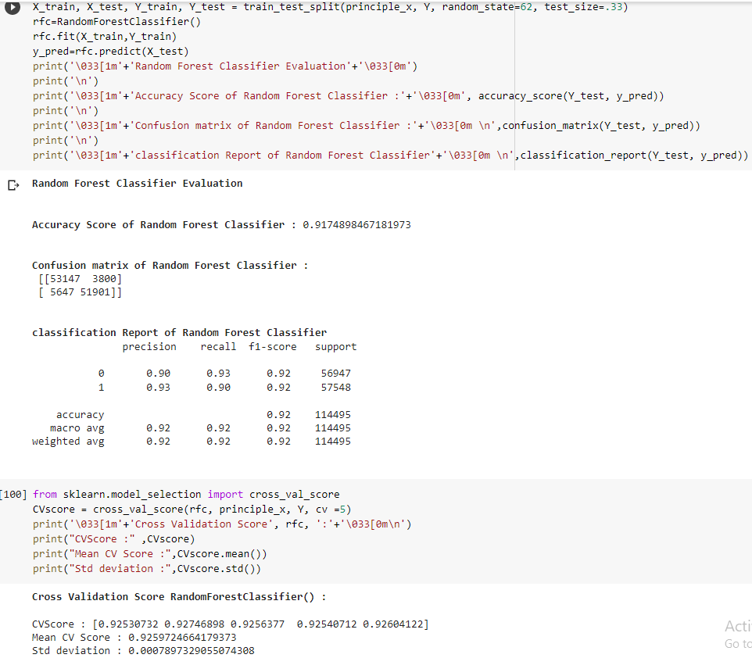
Random Forest Classifier

Slide 22
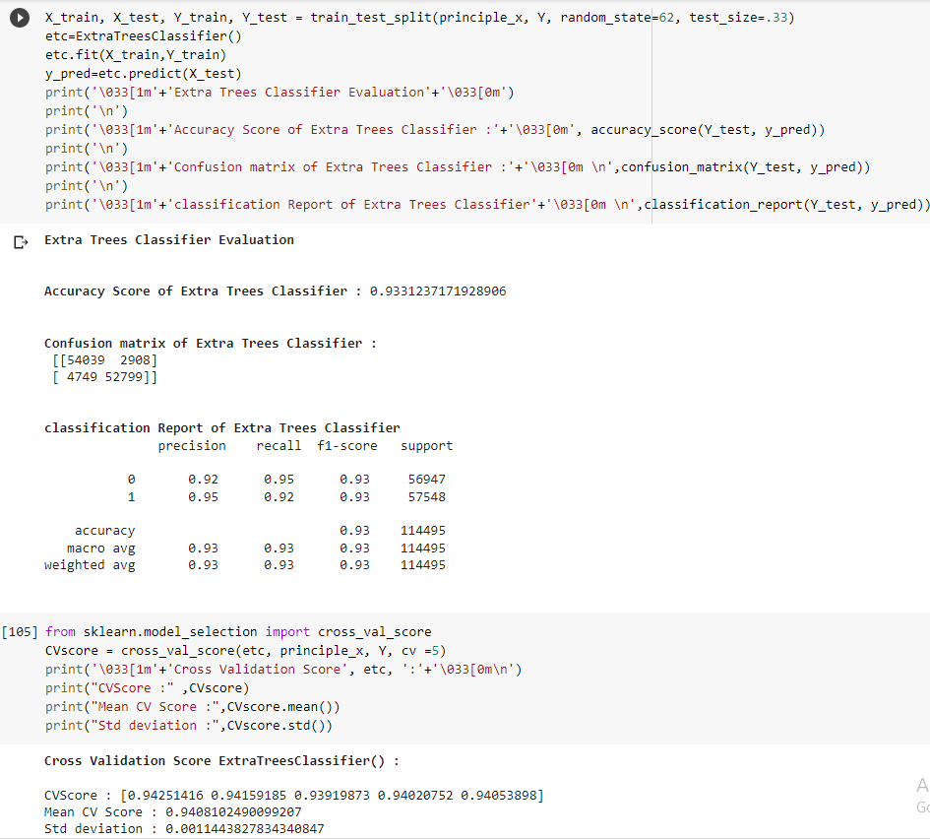
Extra Tree Classifier

Slide 23
Extra Tree classifier gives maximum accuracy and cross validation score.
Hyper parameter Tuning is performed on Extra Tree Classifier gives more accuracy
Extra Tree Classifier model is choosed as a final model.

Slide 24
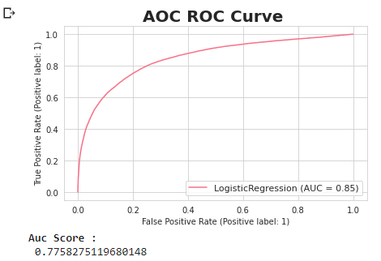
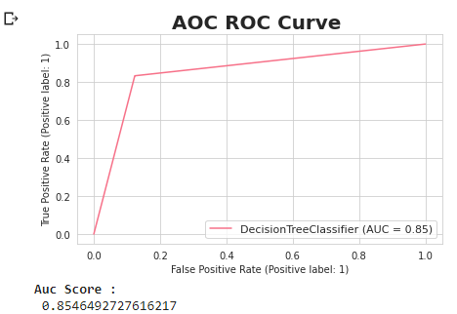
AUC-ROC curve of different models

Slide 25
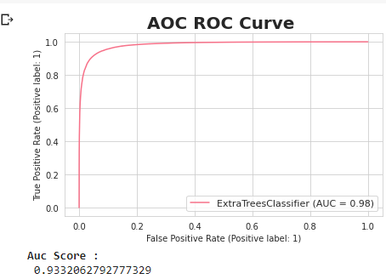
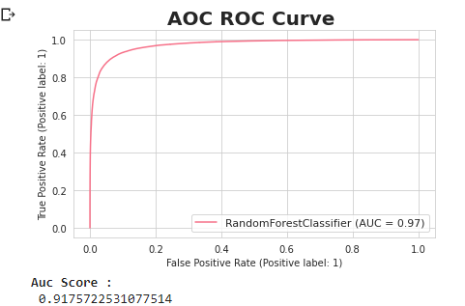
AUC-ROC curve of different models

Slide 26
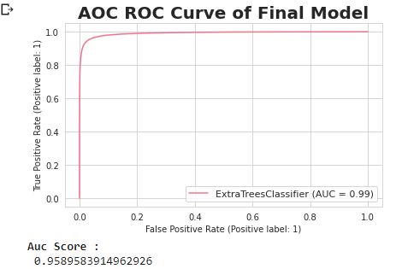
Auc-ROC curve of final model
Extra Tree Classifier Hyper Parameter tuned gives maximum accuracy score of 0.9588803004498013
It also gives us maximum Auc score

Slide 27
Limitations and scope of future of this work
Limited computational resources put limitation on optimization through hyper parameter tuning. Accuracy of model can increase with hyper parameter tuning with several different parameter. Here we use only two parameters for tuning.
Data is imbalanced, we utilised SMOTE for it but if get label data which atleast in ratio of 70:30, it can give us much more realistic model.

Slide 28
Thank you

